Slide 1
OblivP2P: An Oblivious Peer-to-Peer Content Sharing System
Presented by: Alex Williamson (alswilli@ucsc.edu)
De Huo (dhuo@ucsc.edu)
CMPE 253 - Network Security - Prof. Qian - Winter 2019

Slide 2
Table of Contents
Introduction
Problem Definition
Proposed Approach
OblivP2P-1 Distributed Protocol
Implementation and Evaluation
Performance and Security Analysis
Future and Related Work
Conclusion

Slide 3
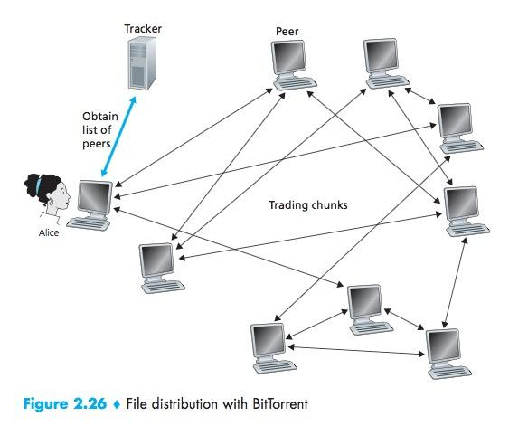
Introduction - P2P Networks
What is a Peer-to-Peer Network?
Popular method for file sharing on Internet
Decentralized traffic unlike client-server
Consist of tracker, peers, P2P protocol
What are the advantages?
Better reliability (peers don’t affect each other)
Increased availability of data
Improved download and upload performance
How popular are P2P Networks?
BitTorrent -> 150 million active users per month
World-Wide Bandwidth -> 3.35% total usage
Notes:
Need to iron trhis transition out with the next slide

Slide 4
Introduction - P2P Security Risks
What are the security risks of P2P Networking?
Long-term traffic analysis (LTTA) of data transactions between peers
Can infer private information about users and their files
Example: Military Intelligence
Frequency of communication -> Urgency or action
Who talks to whom -> Indicates hierarchy
What are some of the current solutions?
Mix Networks
Allow users to be anonymous by hiding online identity
Adversary can link access patterns; still vulnerable to LTTA!
Is anonymizing users enough to protect P2P systems from adversaries?
Notes:
Need to add -> an example

Slide 5
Introduction - OblivP2P: Oblivious Sharing Protocol
What is OblivP2P?
Provides defence against LTTA with oblivious access patterns
Based on Oblivious RAM (ORAM) for hiding data access between client and untrusted memory
What are the challenges with designing OblivP2P?
Obliviousness
P2P systems have much different architecture that client-server
Set of trackers manage network
Multiple peers own data, acting as both clients and servers
Adversarial peers see plaintext, while untrusted servers see encrypted data
Scalability
P2P systems serve data requests simultaneously (versus one at a time)
Throughput must scale linearly with the number of peers
Centralized bottlenecks must be limited
Parallelization must be achieved with decent throughput

Slide 6
Introduction - OblivP2P: Oblivious Sharing Protocol[2]
Solution Overview
Two different protocols proposed: OblivP2P-0 and OblivP2P-1
OblivP2P-0 (Centralized Approach)
All traffic sent through Tracker, creating a computation bottleneck
More direct adaptation of standard ORAM
OblivP2P-1 (Distributed Approach)
Distributes workload of Tracker across network peers
Oblivious Selection (OblivSel) crucial in securing distributed computations
System and Results
Implemented testing on DeterLab testbed using 15 servers and 2¹⁴ (16000) simulated peers
OblivP2P-1 exhibited throughput of 3.19 MBps (approx. 7 requests/sec for 512KB block)
Achieved obliviousness and scalability goals

Slide 7
Table of Contents
Introduction
Problem Definition
Proposed Approach
OblivP2P-1 Distributed Protocol
Implementation and Evaluation
Performance and Security Analysis
Future and Related Work
Conclusion

Slide 8
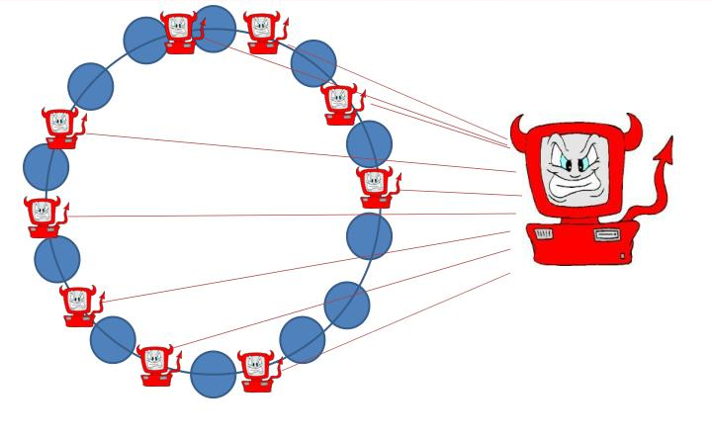
Problem Definition - Threat Model
Paper assumptions
Tracker is a trusted party
Peers are honest-but-curious adversaries
Two main adversarial models for P2P peers
Global Passive Adversary
Peer can view entire network over long period
Later analysis can reveal data and user ID
Ex: BitStalker, Global BitTorrent Monitor
Passive Colluding Peers
Adversary can control multiple peers to gather information
Peers can share access patterns and private storage
OblivP2P tolerates a fraction c ∈ O(N^{E}) of adversarial peers

Slide 9
Problem Definition - Existing Insufficient Solutions
Unlinkability with Mixnet
Set of senders produce messages and send to proxy server(s)
Proxy server(s) mix up the ordering of the messages
Last proxy server sends message to the set of receivers they were meant for

Slide 10
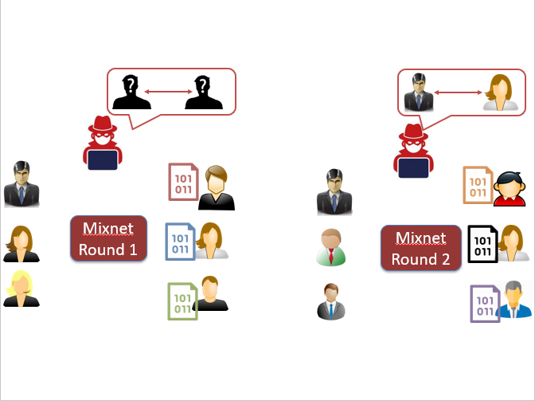
Problem Definition - Existing Insufficient Sols.[2]
Adversary observes two rounds of mixnet communication for Alice and Bob
Let S₁ = {Alice, a, b, c} and S₂ = {a’, b’, Alice, c’} be sets of senders
Let R₁ = {x, y, z, Bob} and R₂ = {x’, y’, Bob, z’} be sets of receivers
After monitoring both rounds, the adversary can infer the sender-receiver link!
Observe that S₁ ⋂ S₂ = {Alice} and R₁ ⋂ R₂ = {Bob}
The link between Alice and Bob is found, thus breaking the unlinkability requirement!
This attack is known as the “hitting set” or “intersection” attack

Slide 11
Table of Contents
Introduction
Problem Definition
Proposed Approach
OblivP2P-1 Distributed Protocol
Implementation and Evaluation
Performance and Security Analysis
Future and Related Work
Conclusion

Slide 12
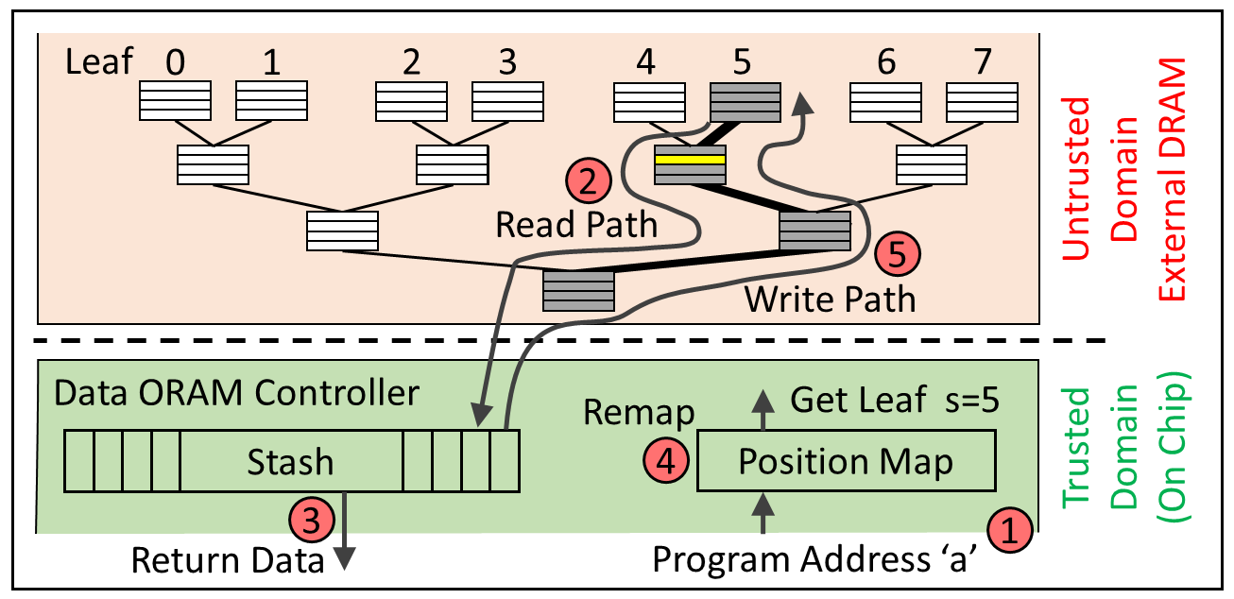
Proposed Approach - Tree-Based ORAM
Path ORAM Review
N: Number of blocks
B: Block size (bits)
Z: Bucket Size (# of blocks)
L: Height of the tree
L = O(logN)
Efficiency:
Overall Bandwidth: 2ZlogN
2 for read AND write
Z = 4 to limit local storage
~8logN total
Notes:
Data blocks have to move around after reads or frequency will be released!
Tree-> Bucket Size = B
Every block assigned to a path from root -> leaf bucket (path is IDed by leaf node l -> we want to find x)
After read, x goes to path r
How to write back without revealing new path-> write to root bucket
Eviction -> goes up towards leaf

Slide 13
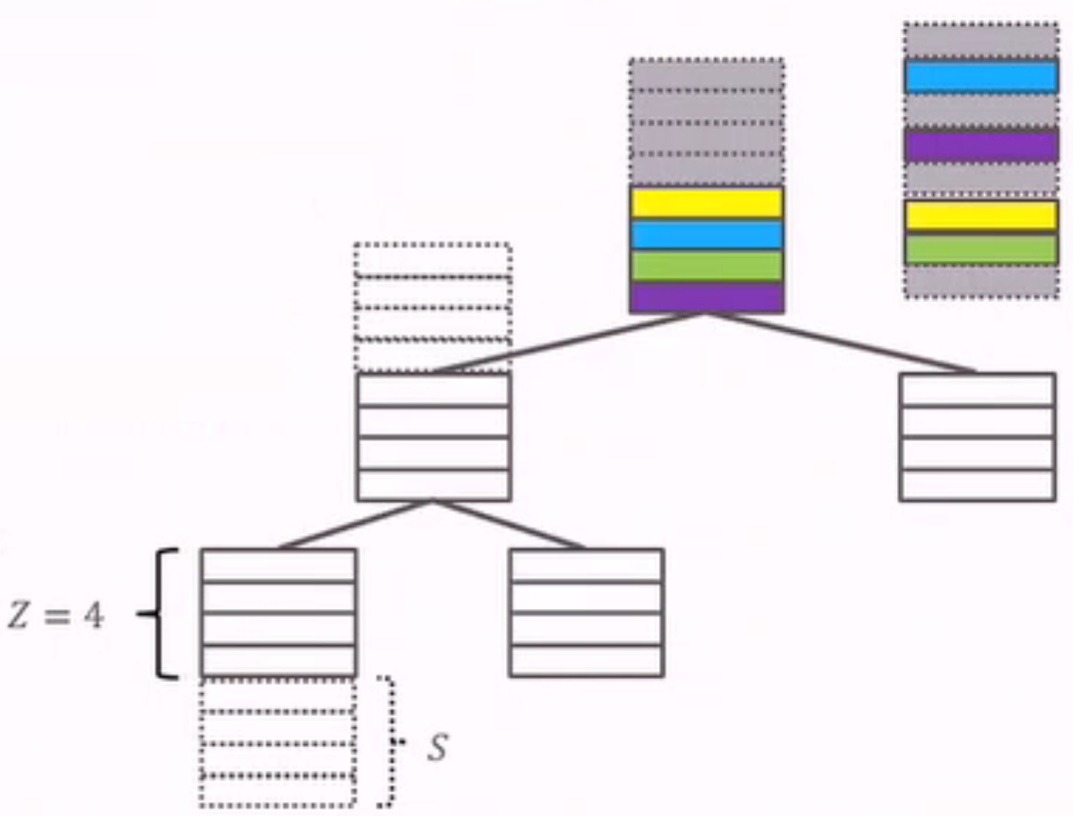
Proposed Approach - Tree-Based ORAM[2]
How does Ring ORAM differ from Path ORAM? (continued)
Two additional parameters
S = Number of additional dummy blocks per bucket
A = Eviction Rate for paths
A = 2Z
Separated Access/Evict Procedures
Access (ReadPath)
Reads either the desired block, or dummy block (if desired not found)
ZlogN -> logN bandwidth for this step
Evict (EvictPath)
Path (stash) evictions only occur after A accesses
Path evictions occur in reverse lexicographic order
Efficiency:
Approaches ~2.5logN bandwidth overall! (depending on Z)
Notes:
Data blocks have to move around after reads or frequency will be released!
Tree-> Bucket Size = B
Every block assigned to a path from root -> leaf bucket (path is IDed by leaf node l -> we want to find x)
After read, x goes to path r
How to write back without revealing new path-> write to root bucket
Eviction -> goes up towards leaf

Slide 14
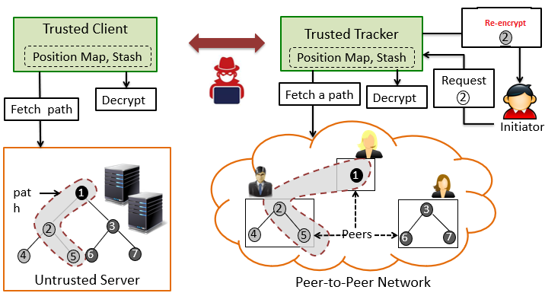
Proposed Approach - OblivP2P-0 Overview
OblivP2P-0 is a direct mapping of ORAM
Sections of binary ORAM tree stored in peers
Tracker acts as the “trusted client”
Initiating peer talks to tracker for access requests
Problem?
Tracker becomes a centralized bottleneck
O(logNB) bandwidth, O(logNE) cost
E = Time for encryption/decryption
Several accesses per second among all peers

Slide 15
Table of Contents
Introduction
Problem Definition
Proposed Approach
OblivP2P-1 Distributed Protocol
Implementation and Evaluation
Performance and Security Analysis
Future and Related Work
Conclusion

Slide 16
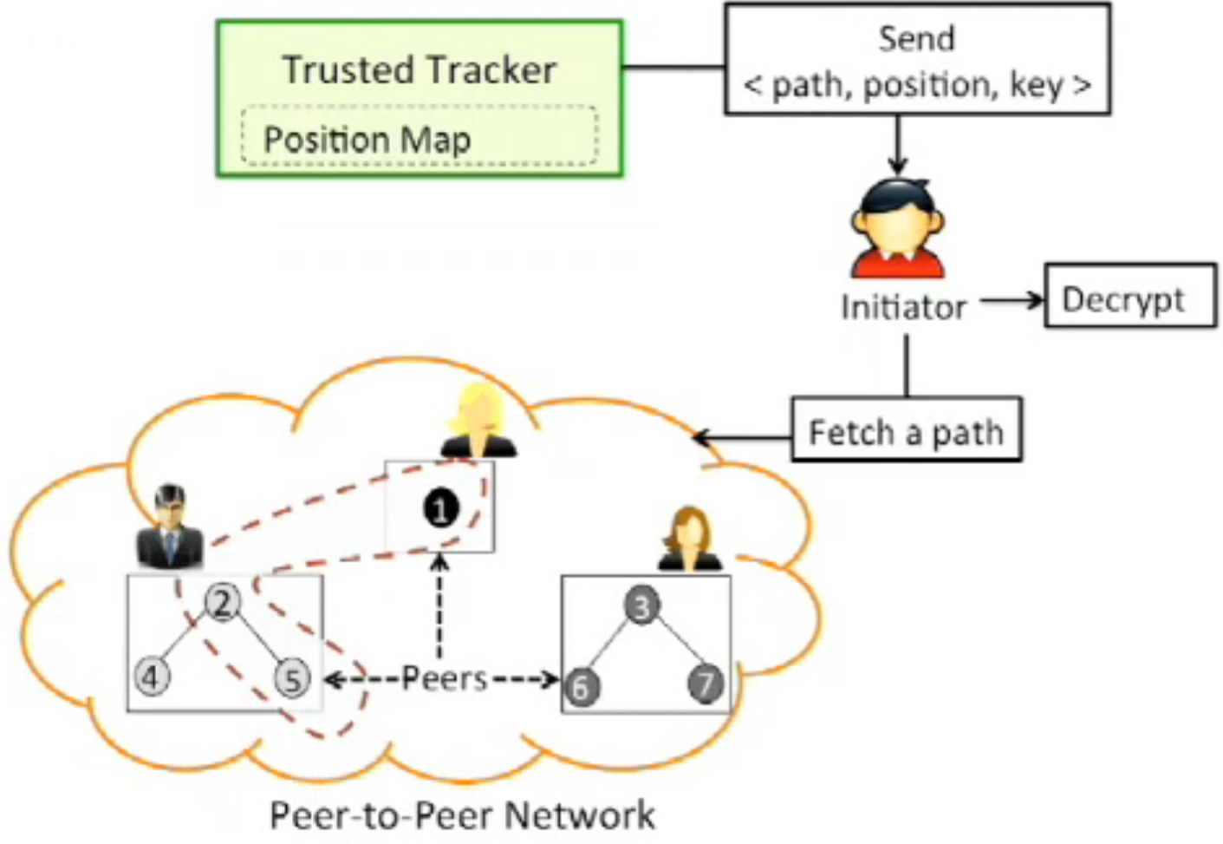
OblivP2P-1 Distributed Protocol - Overview
Tracker leverages initiator to eliminate ORAM overhead
Initiator gets <path, position, key> needed to access resource
Initiator fetches path and performs decryption/re-encryption of path
Peers hold stash (encrypted) and communicate with initiating peer

Slide 17
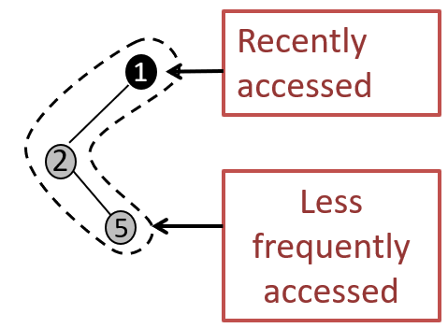
OblivP2P-1 Distributed Protocol - Overview[2]
Problem?
After N evictions, heavily accessed blocks located toward “top” of tree
Adversarial peers can now infer the contents of blocks based on their position!
“Block History” problem
What is the solution?
A primitive is needed to ensure a peer can get its desired block WITHOUT:
Knowing the block position
Gaining access to cryptographic key(s)
No centralized tracker bottleneck
This primitive is Oblivious Selection (OblivSel)

Slide 18
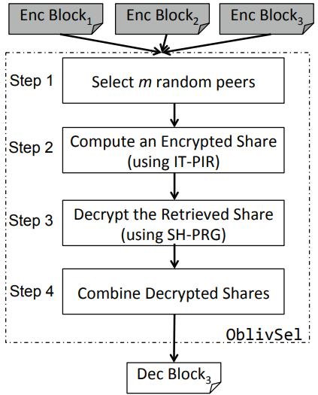
OblivP2P-1 Distributed Protocol - OblivSel
Step 1
Set of m random peers selected by Tracker
High probability of at least one peer being honest
Each peer fetches all blocks in desired path
Step 2
Tracker computes IT-PIR queries and sends to peers
Peers compute encrypted share using queries and blocks
Step 3
Tracker sends share of private key to m peers
Peers input keys into SH-PRG function to decrypt desired block
Step 4
Decrypted shares are sent to the initiating peer
Combination of all shares form the desired plaintext

Slide 19
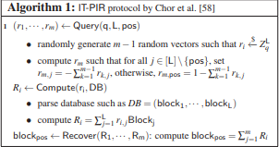
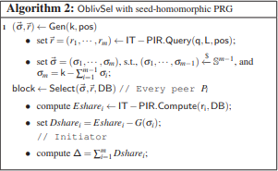
OblivP2P-1 Distributed Protocol - OblivSel[2]

Slide 20
OblivP2P-1 Distributed Protocol - OblivSel[3]
IT-PIR (Information theoretical private info retrieval) for computing encrypted share
IT-PIR Query: ( Tracker )
Input : block position
Output : queries for m randomly selected peers
IT-PIR Compute: ( m peers )
Input : corresponding query and all Encrypted blocks required
Output : one Encrypted Share_{i}
Queries
Tracker
Peer₁ , Peer₂ , Peer₃ , … Peer_{m}
Position
Queries
Query
Enc blocks
Enc Share_{i}
IT-PIR. Query
IT-PIR.Compute

Slide 21
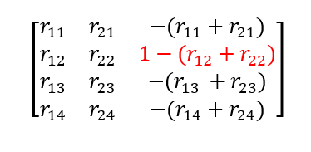
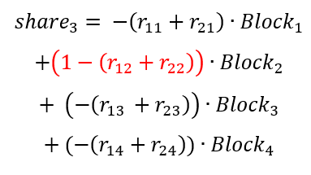
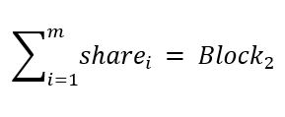
OblivP2P-1 Distributed Protocol - OblivSel[3]
IT-PIR (Information theoretical private info retrieval) for computing encrypted share
m = 3
L = 4
Target Position = 2

Slide 22
OblivP2P-1 Distributed Protocol - OblivSel[4]
SH-PRG (seed homomorphic pseudo random gen.) for decrypting retrieved share
Purpose: without giving away the one private key generated by tracker.
Encrypted block = block + G(k)
block = Encrypted block - G(k)
m Key Shares
Tracker
Peer₁ , Peer₂ , Peer₃ , … Peer_{m}
Key share_{i}
Enc Share_{i}
Private Key
Seeds for PRG
(Key Share)
G(K_{i})
PRG
Enc Share_{i} - G(K_{i})
Dec Share_{i} of block

Slide 23
OblivP2P-1 Distributed Protocol - OblivSel[3]

Slide 24
OblivP2P-1 Distributed Protocol - OblivSel[4]
OblivSel Summary
Tracker:
OblivSel.Gen:
IT-PIR. Query
Generate private key and seeds for PRG
Peers:
OblivSel. Select:
IT-PIR. Compute
PRG
Decrypt(Encrypt) block

Slide 25
OblivP2P-1 Distributed Protocol - OblivSel[5]
Why OblivSel is position hiding:
There is at last one non-colluding peer in m randomly selected peers.
Pseudo random generator( PRG ) is secure.
None of the peers could get the actual block position and private key.
OblivSel is Parallelizable
Each peer gets all the required Encrypted blocks to local
throughput

Slide 26
OblivP2P-1 Distributed Protocol - Final Design
P2P network state metadata kept in Tracker:
Network connections per peer
A lookup associating a resource to a set of peer identifiers
FileMap: file id → block address
Tag(leaf)Map: block address → path
PosMap: block address → path and bucket position
KeyMap: block address → key value
StashList: list of peers who contain stash
NetMap: peer’s id → peer’s network information ( IP, Port )
Counter: last Eviction step

Slide 27
OblivP2P-1 Distributed Protocol - Final Design[2]
A formalized the P2P protocol includes:
Trusted Tracker
A set of untrusted peers
Operations:
Setup: Tracker sets up the initial state in the P2P network
Upload: A peer uploads a file to a set of peers and updates states in tracker
Fetch: A peer fetches a file from a set of peers and update states in tracker
Sync: Tracker evicts the stash and updates its states

Slide 28
OblivP2P-1 Distributed Protocol - Final Design[3]
Setup Operation:
Different peers handle different number of buckets depending on its local available storage
Tracker sets up the state metadata
Tracker randomly select m peers to store the stash and records the peers in StashList

Slide 29
OblivP2P-1 Distributed Protocol - Final Design[4]
Fetch Algorithm:
Trusted Tracker
File id
Initiator
FileMap (file_id) → [Block Addresses]
For each (address):
TagMap (address) → tag
PosMap (address) → block position
KeyMap (address) → key
The Tracker finds the blocks metadata with the file id.

Slide 30
OblivP2P-1 Distributed Protocol - Final Design[5]
Fetch Algorithm:
key
block position
Tag
Trusted Tracker
File id
Initiator
(Key, block position)
OblivSel.Gen
Key shares, Queries
OblivSel.Gen:
(1). Picks uniformly at random m peers.
(2). Generate the key share and position Queries for each of m peers.

Slide 31
OblivP2P-1 Distributed Protocol - Final Design[6]
Fetch Algorithm:
Key shares
Position queries
Tag
Trusted Tracker
File id
Initiator
Key shares
Position queries
Tag
Peer₁ , Peer₂ , Peer₃ , … Peer_{m}
OblivSel.Select

Slide 32
OblivP2P-1 Distributed Protocol - Final Design[7]
Fetch Algorithm:
Trusted Tracker
File id
Initiator
Key shares
Position Queries
Tag
Peer₁ , Peer₂ , Peer₃ , … Peer_{m}
Position Queries
Stash + Tag
IT - PIR
Encrypted Shares

Slide 33
OblivP2P-1 Distributed Protocol - Final Design[8]
Fetch Algorithm:
Trusted Tracker
File id
Initiator
Block
Key shares
Encrypted Share
Peer₁ , Peer₂ , Peer₃ , … Peer_{m}
Key share, Encrypted share
SH - PRG
Decrypted Shares

Slide 34
OblivP2P-1 Distributed Protocol - Final Design[9]
Fetch Algorithm: Re-encryption, Update state and stash
Trusted Tracker
Update state
Generate a new Key
Append the re-encrypted block to stash
(new Key, block position)
OblivSel.Gen
Key shares, Position Queries
OblivSel.Select
(Key shares, Position Queries)

Slide 35
OblivP2P-1 Distributed Protocol - Final Design[10]
Sync Algorithm
Updating the state of the network
Evicting the stash

Slide 36
OblivP2P-1 Distributed Protocol - Final Design[11]
Sync Algorithm
1. The tracker selects a path to evict the stash.
2. All blocks [ A ] in stash and path, generate a new permutation [ A’ ]
4. Each blocks in [ A ] is mapped obliviously to a place in [ A’ ]

Slide 37
OblivP2P-1 Distributed Protocol - Final Design[12]
Sync Algorithm: Oblivious mapping
Trusted Tracker
Peer₁ , Peer₂ , Peer₃ , … Peer_{|stash| + Z*L}
Key shares
Position Queries
Tags
Generate a new Key for each block position in [ A ]
OblivSel.Select
(new Key, new block position)
OblivSel.Gen
Key shares, Position Queries
Peers stores [ A ] at new block position [ A‘ ]

Slide 38
OblivP2P-1 Distributed Protocol - Final Design[13]
Upload Algorithm
1. A peer requests a tracker to upload a file.
2. The tracker randomly selects m peers.
3. The peer sends m shares of a block to m peers.
4. The tracker generates a unique key and sends m key shares to m peers.
5. The m peers run PRG and add it to the received share.
Enc(k, Block) = Block + G( k )
6. A random selected peer will hold this Encrypted block.

Slide 39
OblivP2P-1 Distributed Protocol - Optimization
Optimization goal:
Increasing the P2P network throughput
Optimizations:
Generate Replication of every block in the tree
Support parallel accesses
Deploy multiple trackers
Every peer creates several copies of it’s bucket space and run the Protocol on different version of buckets.
3. Parallelizing Computation
Peer = a set of peers
Run The Protocol in Parallel

Slide 40
Table of Contents
Introduction
Problem Definition
Proposed Approach
OblivP2P-1 Distributed Protocol
Implementation and Evaluation
Performance and Security Analysis
Future and Related Work
Conclusion

Slide 41
Implementation and Evaluation
Implementation
Ring ORAM:
bucket contains z = 4 blocks and s = 5 dummy blocks
eviction occurs after every 3 accesses.
IT-PIR and seed homomorphic PRG
Encryption based on ECC library
Random number:
NIST P-256 elliptic curve

Slide 42
Implementation and Evaluation
Implementation
DeterLab network testbed
Server:
15 servers running Ubuntu 14.04
Intel(R) Xeon(R) hexa core processors, 2.2 Ghz, 15 MB cache (24 cores each)
24 GB of RAM
Each peer process takes up to 4 − 60 MB memory
Tracker is connected to a 128 MBps link

Slide 43
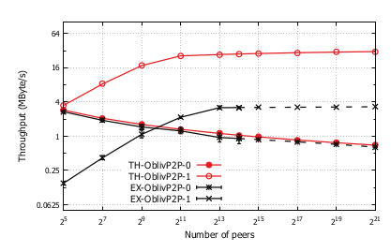
Implementation and Evaluation
Throughput
OblivP2P-0 decreases with the growth of the network (Tracker Queueing the requests)
OblivP2P-1 increases throughput with the network growing because of distribution of computing.
The throughput of OblivP2P-0 and OblivP2P-1 linearly scales with network increase.

Slide 44
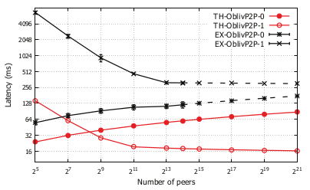
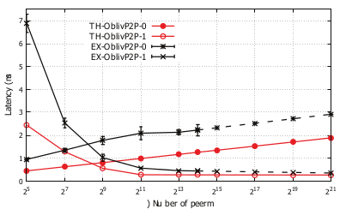
Implementation and Evaluation[2]
Latency
OblivP2P-1 has a higher latency for fetching.
OblivP2P-1 sync time becomes steady in the large network.
The latency for fetching block
The latency for sync algorithm

Slide 45
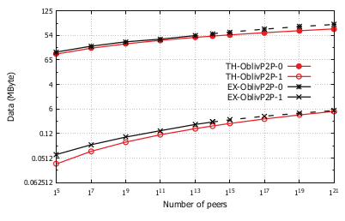
Implementation and Evaluation[3]
Data Transferred through Tracker
Compare with OblivP2P-0, OblivP2P-1 has no centralized bottleneck
The data transferred through tracker

Slide 46
Table of Contents
Introduction
Problem Definition
Proposed Approach
OblivP2P-1 Distributed Protocol
Implementation and Evaluation
Performance and Security Analysis
Future and Related Work
Conclusion

Slide 47
Performance and Security Analysis
Performance
Tracker overhead
Eviction
Eviction does OblivSel ( L * z + |stash| ) times. L and |stash| is O(logN)
IT-PIR.Query costs logN * ( L * z + |stash| )
Eviction costs O(logN³)
Peers overhead
Communication overhead
Receives ( L * z + |stash| ) blocks from the peers
Transmit O( logN / N ) blocks per access
Computation overhead
O( logN⁴ / N )

Slide 48
Performance and Security Analysis[2]
Security
Definition of a oblivious P2P system:
For any PPT(Probabilistic Polynomial Time) “honest-but-curious” adversary,
the adversary’s issuing access patterns’ success probability is smaller than a
negligible probability.
OblivP2P-1 is a oblivious P2P system:
If ∀N > 1, and ∀ε < 1, ∃m > 1, such that
2^{logN · m · (1 - ε)} ∈ negl( λ )
N: Number of blocks
ε: Proportion of colluding peers
m: The number of peers involving one access

Slide 49
Table of Contents
Introduction
Problem Definition
Proposed Approach
OblivP2P-1 Distributed Protocol
Implementation and Evaluation
Performance and Security Analysis
Future and Related Work
Conclusion

Slide 50
Future and Related Work
Long term traffic analysis
Other Anonymous P2P systems: Crowds, AP3, ShadowWalker. etc
Problem of other systems: Show limits against global adversary with long term traffic analysis
Side-channels
Attacker implements Machine learning methods to identify the user’s private information
Out of scope, not relevant with long-term pattern traffic analysis
Multi-servers and parallel ORAM
Optimizing ORAM constructions: Leveraging multiple servers, Multiple CPUs, etc
Problem : not fit to P2P network system, single peer bottleneck
Oblivious parallel RAM (OPRAM)
Problem : OPRAM does not decrease the communication overhead, bottleneck

Slide 51
Table of Contents
Introduction
Problem Definition
Proposed Approach
OblivP2P-1 Distributed Protocol
Implementation and Evaluation
Performance and Security Analysis
Future and Related Work
Conclusion

Slide 52
Conclusion
OblivP2P is a oblivious P2P Protocol.
OblivP2P could defend the long-term pattern traffic analysis
OblivP2P-1 avoids bottleneck at Tracker and could be linearly scalable with increase in the number of peers.
OblivP2P is parallelizable.

Slide 53
Conclusion - References
https://www.usenix.org/system/files/conference/usenixsecurity16/sec16_paper_jia.pdf (slides and paper)
https://www.usenix.org/system/files/conference/usenixsecurity15/sec15-paper-ren-ling.pdf (slides and paper)
Notes:
Still need to add more references

